Slide 1
B. Tech. Project
Data Driven Modelling of Composites
End-Term Evaluation
Advisor -
Prof. Siladitya Pal
Aman Shrivastava - 13117008
Mihir Ujjwal Rana - 13117044
Yash Sharma - 13117079

Slide 2
Objective
To develop an algorithmic framework to predict properties of composites to aid in meta-modelling process.

Slide 3
Introduction
Composites -
Composites are made by combining two or more natural or artificial materials to maximize their useful properties and minimize their weaknesses. One of the oldest and best-known composites, glass-fiber reinforced plastic (GRP), combines glass fibers (which are strong but brittle) with plastic (which is flexible) to make a composite material that is tough but not brittle. Composites are typically used in place of metals because they are equally strong but much lighter.

Slide 4

Applications
Airbus A380
More than 20 % of the A380 is made of composite materials, mainly plastic reinforced with carbon fibres. The design is the first large-scale use of glass-fibre-reinforced aluminium, a new composite that is 25 % stronger than conventional airframe aluminium but 20 % lighter.

Slide 5
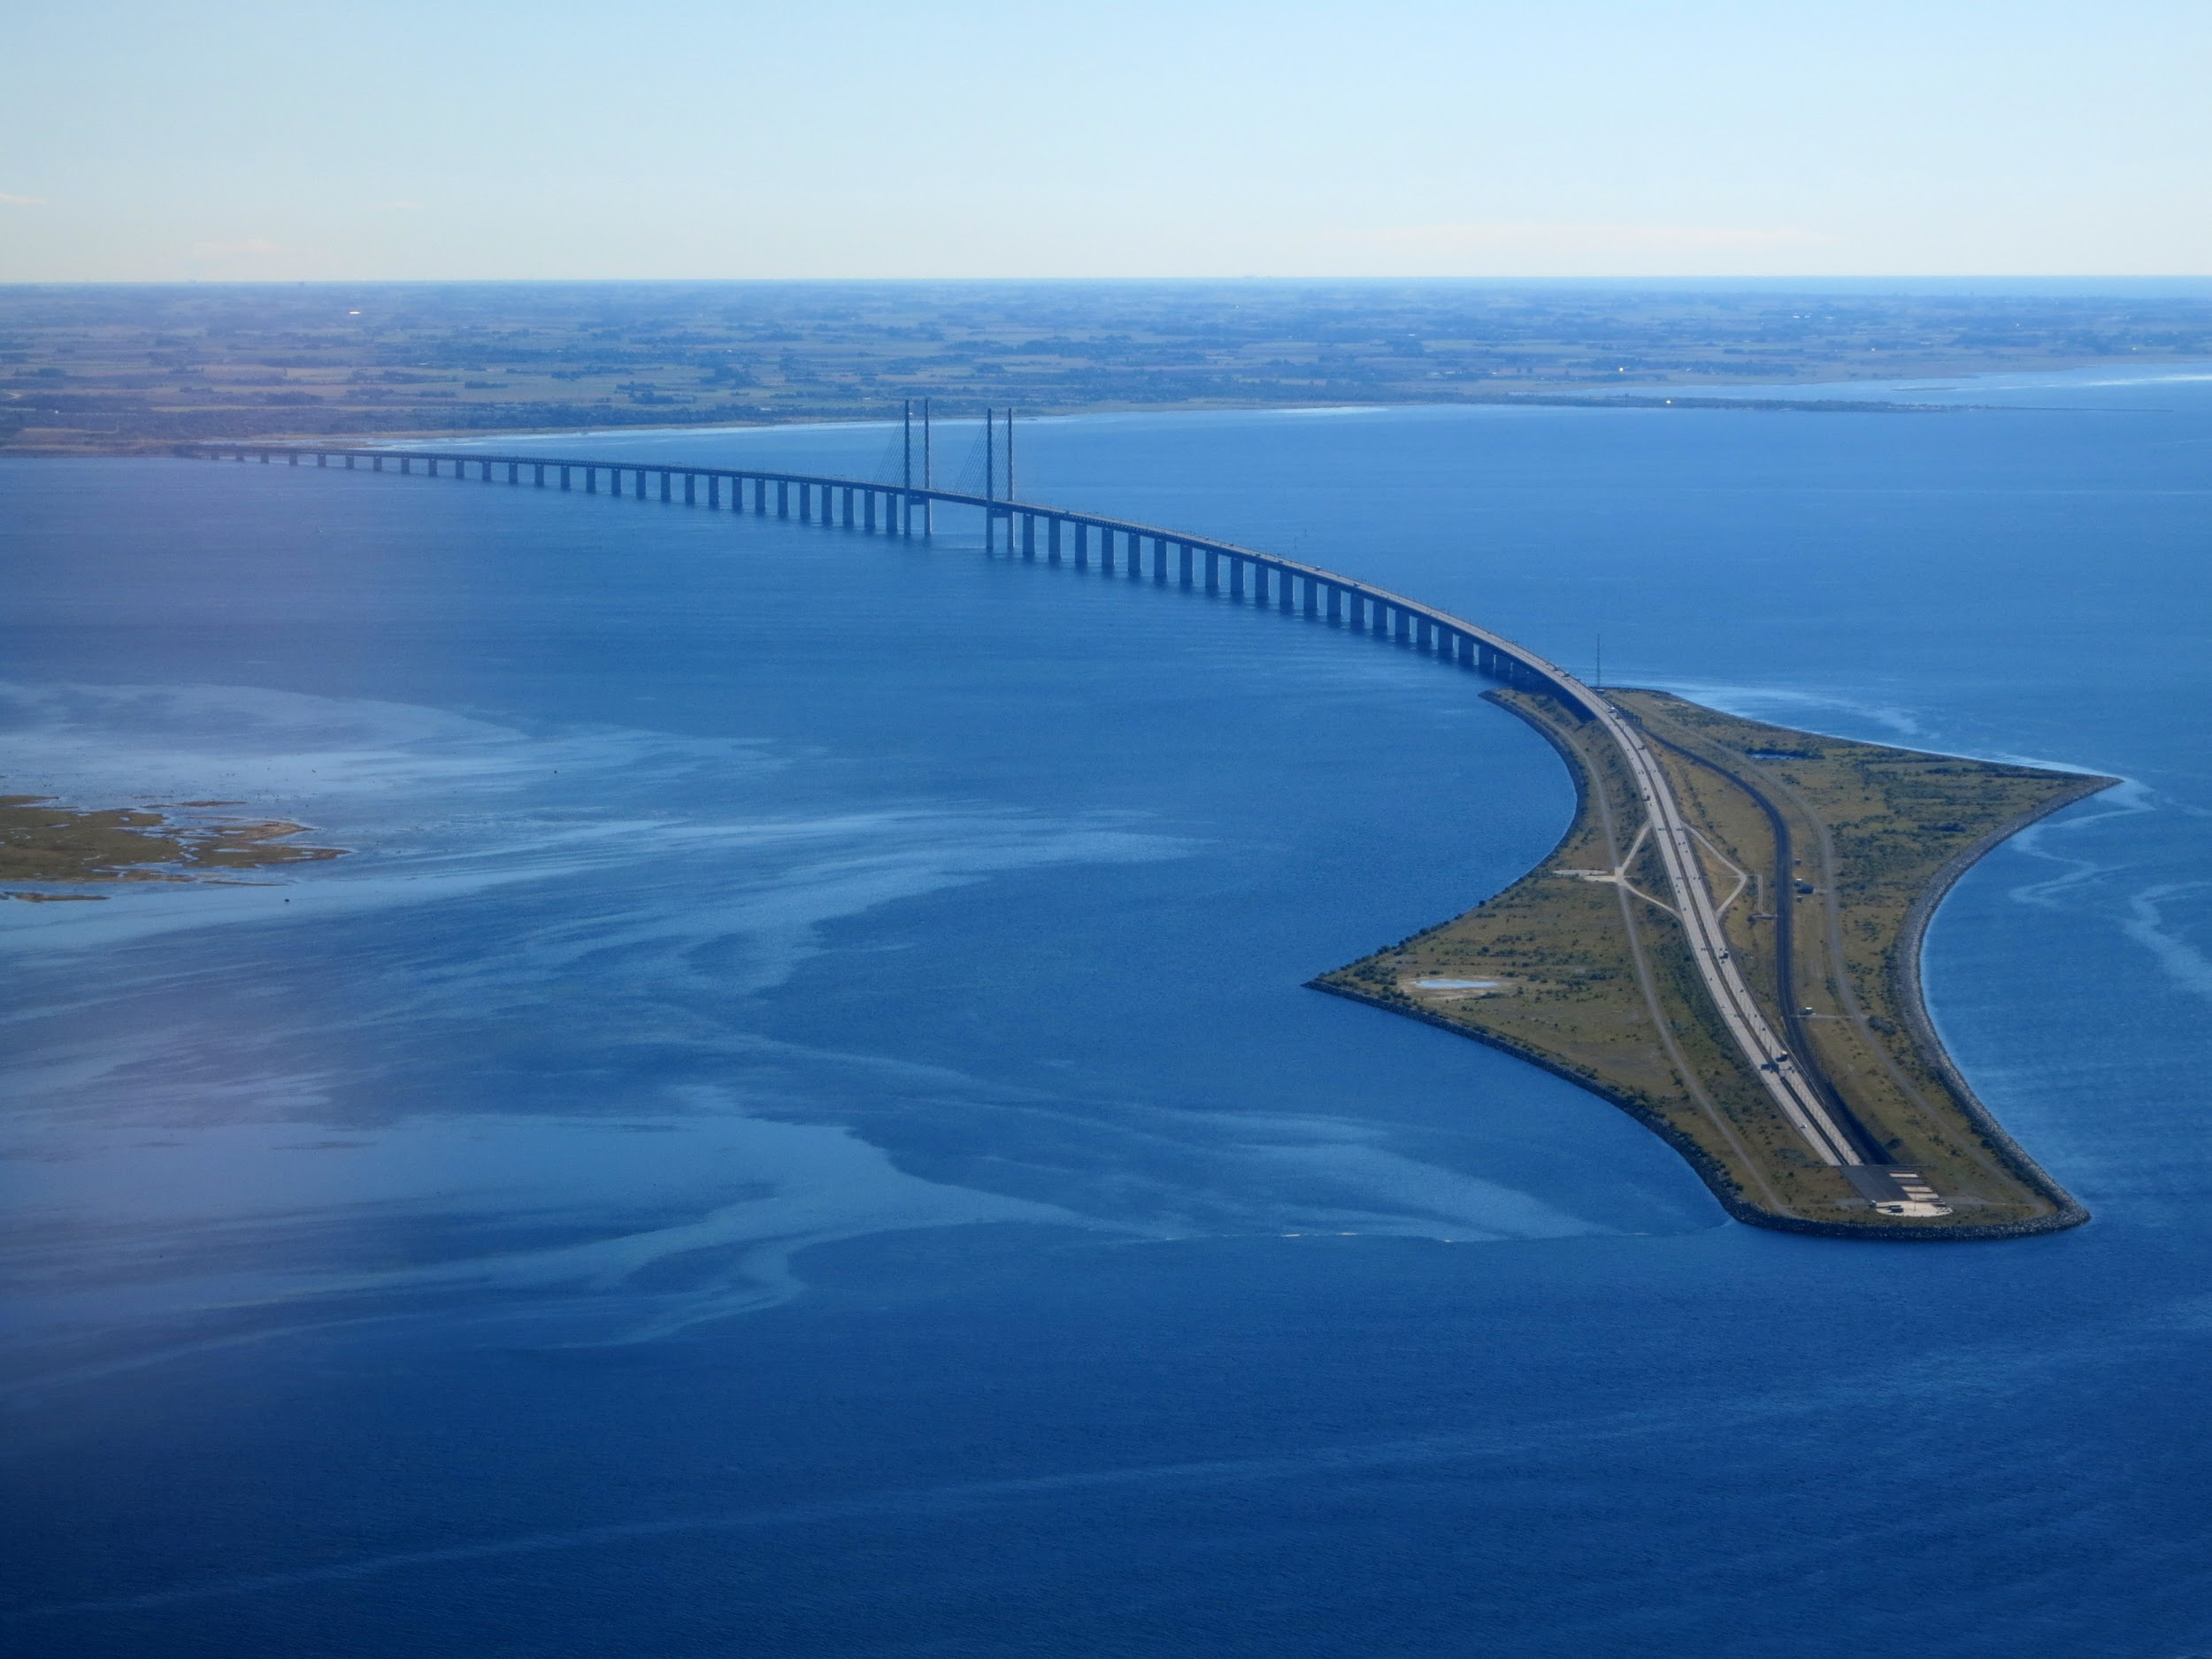
Applications
Concrete
Concrete is a versatile and cheap material, with a vast range of applications around the home. Brick laying, constructing paths and driveways, foundations to buildings and walls, are some of the practical applications. Concrete has a similarly wide and varied range in industrial applications.

Slide 6
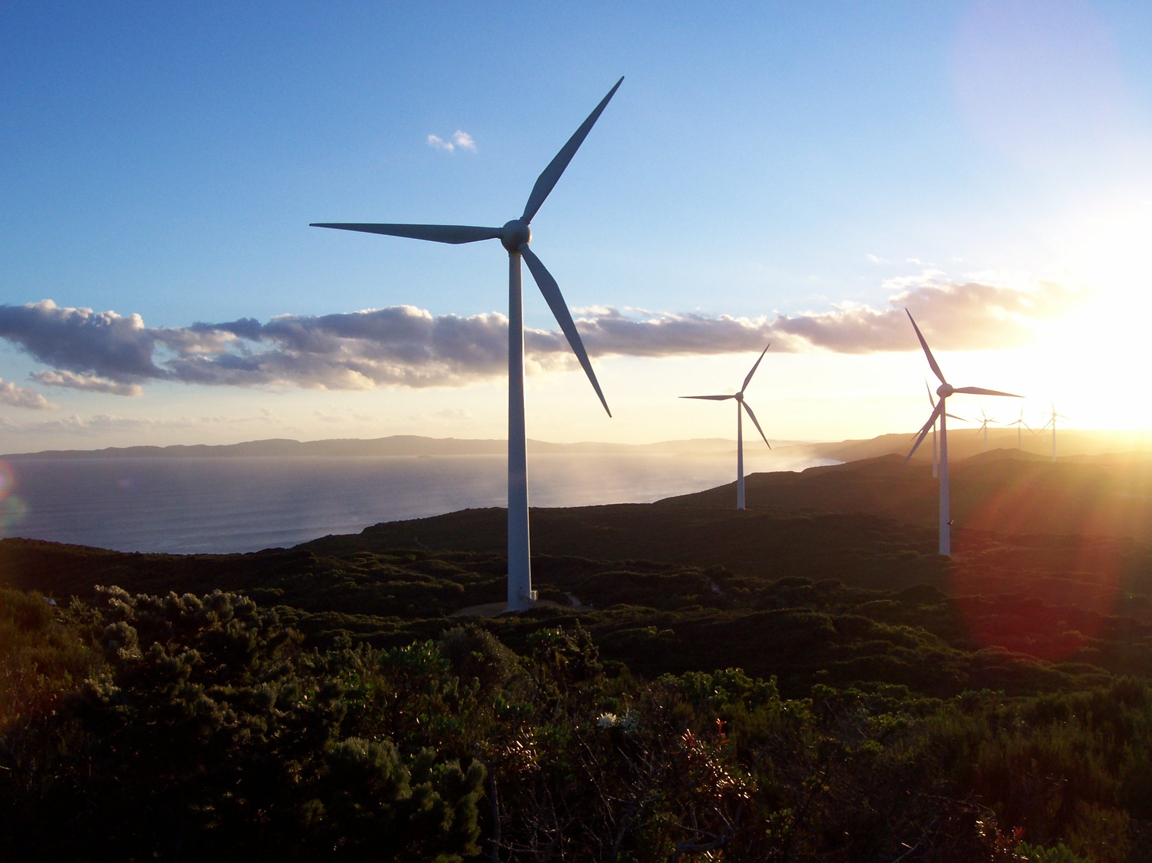
Applications
Wind Turbine
Currently, carbon fiber is used primarily in the spar, or structural element, of wind blades longer than 45m/148 ft, both for land-based and offshore systems. The higher stiffness and lower density of CF allows a thinner blade profile while producing stiffer, lighter blades.

Slide 7
Methodology
FE Model development for simulation of mechanical behaviour of particulate composites.
Create input database based on several mechanical properties, like Young’s Modulus, Poisson’s Ratio, Volume Fraction, spatial arrangements of particles, etc.
Perform simulations and extract stress-strain behaviour for several cases.
Create a meta-model using Machine Learning algorithms.
Generate composites with unknown material properties.
Predict with meta-model, and validate the results with direct FE simulations.

Slide 8
General Workflow Structure
1. (a) Images
2. Structure Factor
3. Master Data
1. (b) Simulated Data
6. Trained Model
5. Machine Learning
4. Preprocessed Data
7. Predictions
8. Validation

Slide 9
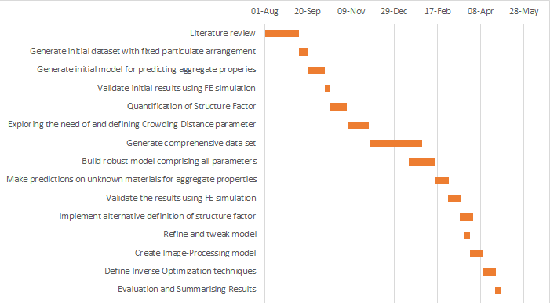
Project Timeline

Slide 10
Progress Made
Database Generation
Structure Factor Quantification
ML Model Generation
Generation of database comprising several particulate composites with different properties
Creation of parameter to quantify difference in composites with same properties and volume fraction but different spatial arrangement of particles
Generation of meta-model using Machine Learning algorithms
Making predictions using this model

Slide 11
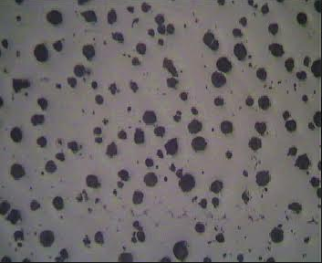
Structure Factor Quantification

Slide 12
(i) (ii) (iii)
Difference?

Slide 13
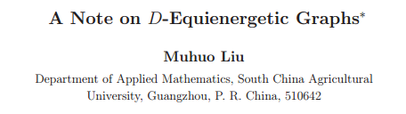
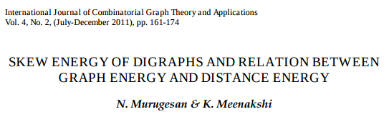

Distance Energy
The D-eigenvalues of a graph G are the eigenvalues of its distance matrix D , and the D-energy E_{D}(G) is the sum of the absolute values of its D-eigenvalues.
Two graphs are said to be D-equienergetic if they have the same D-energy. It has been proved that there exist pairs of non-D-cospectral D-equienergetic graphs of order n for every n ≥ 6 .

Slide 14
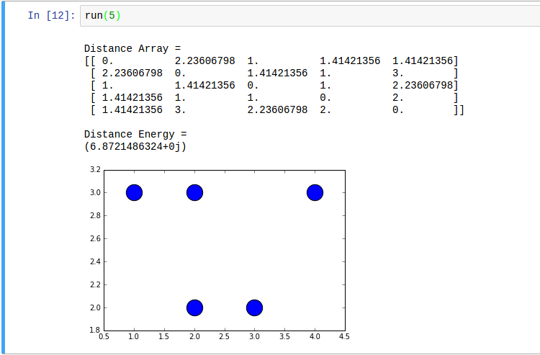
Distance Energy
Sample Computation for 5 particle system

Slide 15
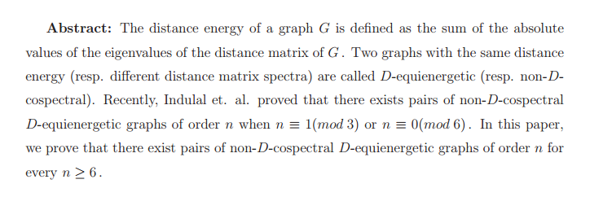
Need for Crowding Factor Quantification

Slide 16
Activities to be Followed
Generation of large database spanning across various types of materials with information about exact location of all particles.
Creation of a parameter to quantify crowding of particles within a sample to distinguish between equi-energetic distributions.
Implement alternative definition of Structure Factor using Fourier transformation techniques to check if results improve.
Validation of model by comparison with direct FE simulation, according to an appropriate confidence interval band.
Generation of an Image-Processing based engine to directly identify all particles and their respective locations from image for inputting in the ML model.
Definition of Inverse Optimization techniques to recommend materials and particulate arrangement, given target properties such as strength or structure factor.

Slide 17
Additional Help Required
High performance workstations are a must for our efforts to fructify. We would need high parallel-computing power (available in our advisor’s office and at the ICC).
Since the validation process comprises comparison with real data, we would need FE simulated data to compare the material properties with our predictions. Simulations would primarily be handled by our advisor.
If time permits, we would also be doing experimental validation by testing on loaded materials in a laboratory.

Slide 18
References
Balakrishnan R., The Energy of a Graph Linear Algebra and Its Applications, 387, (2004), 287-295.
N. Murugesan, K. Meenakshi, Skew Energy of Digraphs and Relation Between Graph Energy and Distance Energy, International Journal of Combinatorial Graph Theory and Applications (2011), 161-174

Slide 19
Thank You!
Any Questions?

